Slide 1
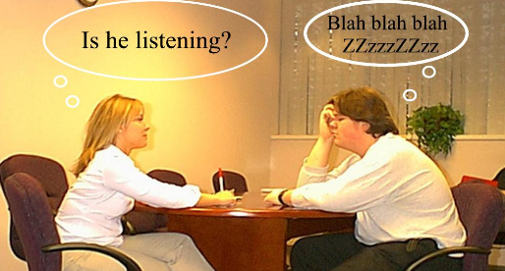
Be an Active Listener
Team 6
Sameera Mohamed
Ganesh Rao
Suvham Patro
Bhargav Balla

Slide 2
What is Active Listening?
Active listening is fully concentrating, understanding, responding, and remembering what is being said.
Emphasizes respect and empathy in communication.
Key to building trust and improving relationships.

Slide 3
Why is Active Listening Important?
- Builds stronger relationships, both personal and professional.
- Enhances collaboration and teamwork.
- Reduces misunderstandings and conflicts.
- Boosts problem-solving and creativity by encouraging diverse perspectives.

Slide 4
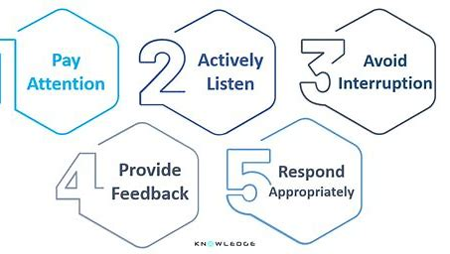
Key Elements of Active Listening

Slide 5
How to Be an Active Listener – Steps to Follow
1. Clear Your Mind: Let go of distractions, be mentally present.
1
2. Use Non-Verbal Cues: Show interest with gestures and facial expressions.
2
3. Avoid Interrupting: Allow the speaker to finish their thoughts.
3
4. Ask Clarifying Questions: Shows interest and ensures understanding.
4
5. Provide Constructive Feedback: Be thoughtful and supportive in your response.
5

Slide 6
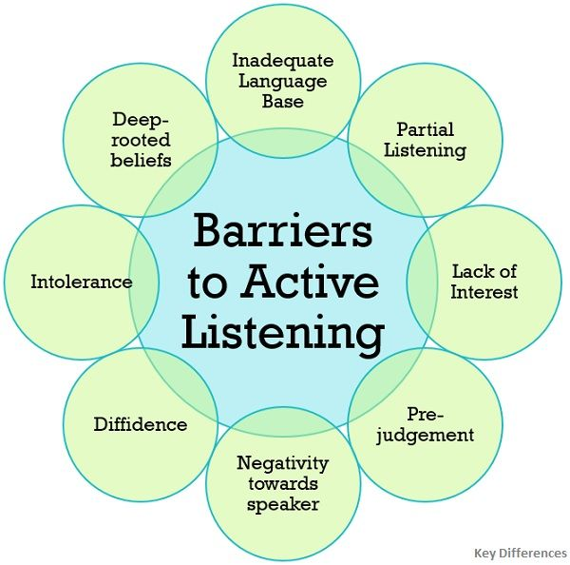
Barriers to Active Listening

Slide 7
Techniques to Enhance Active Listening
- Paraphrasing: 'What I’m hearing is…'
- Summarizing: 'To summarize, you’re saying that…'
- Reflective Questions: 'How did that make you feel?'
- Empathy Statements: 'That sounds challenging; I understand why you feel that way.'

Slide 8
Benefits of Practicing Active Listening Daily
- Improved understanding and reduced conflicts.
- Enhanced interpersonal skills.
- Better decision-making through comprehensive insight.
- Strengthened connections in personal and professional settings.

Slide 9
Conclusion
Active listening is a valuable skill that strengthens communication and relationships.
Practice is essential—commit to listening actively every day.

Slide 10


